Slide 1

Bank of England
Speech Sentiment Analysis
May 28th, 2025
Notes:
Hello, it is very nice to meet you.

Slide 2

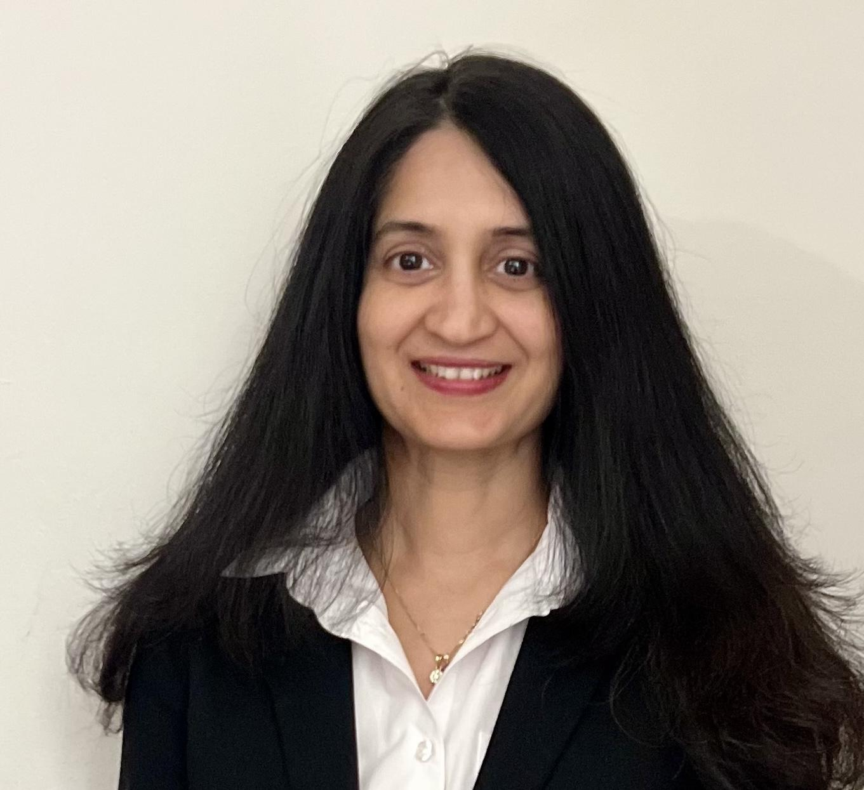


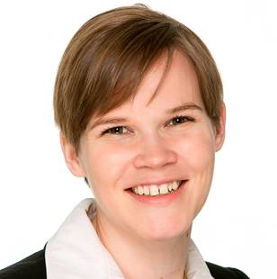


Team AnalytIQ
Yann Hirsig
Lalitha Vemuri
Karin Agius Ferrante
Louis Pang
Reka Bodo
Christina Tsoulfa
Notes:
My name is Dr. Karin Agius Ferrante and I will present the findings of our team AnalytIQ that were developed for the Bank of England data strategy team.

Slide 3
How do speeches and sentiment develop over time?
How does speech sentiment relate to economic events?
How is speech sentiment correlated with economic indicators?
Notes:
We have used Python in Jupyter notebook and researched economic indicators to answer these three questions:

Slide 4
Executive Summary
Key Insights
BoE speeches are increasingly concise & frequent.
Governor tone is more optimistic.
Major events and MPC voting results drive shifts in speech sentiment.
Weak standalone correlation of speech sentiment with economic indicators.
Hybrid models offer stronger predictive insights.
Most influential features are consumer confidence, credit growth and interest rates.
Recommendations
Strengthen communication impact
Strengthen modelling precision
Strengthen policy accountability
Notes:
So these are the key insights we found
And we will share the details of the recommendations after

Slide 5

How do speeches and sentiment develop over time?

Slide 6
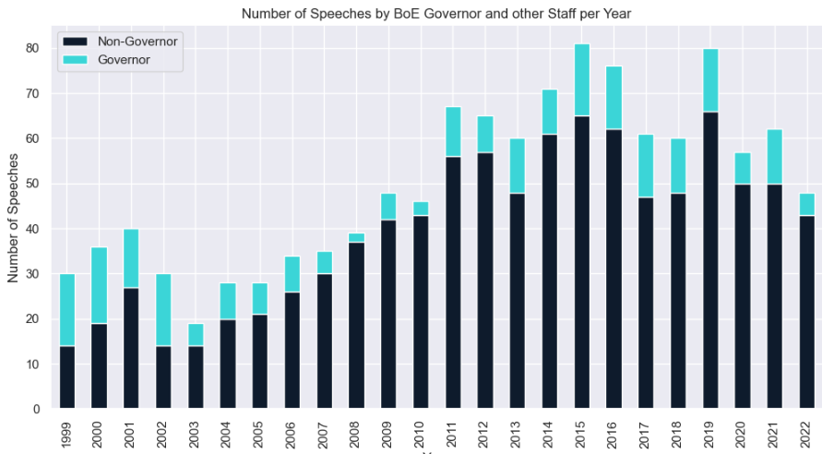
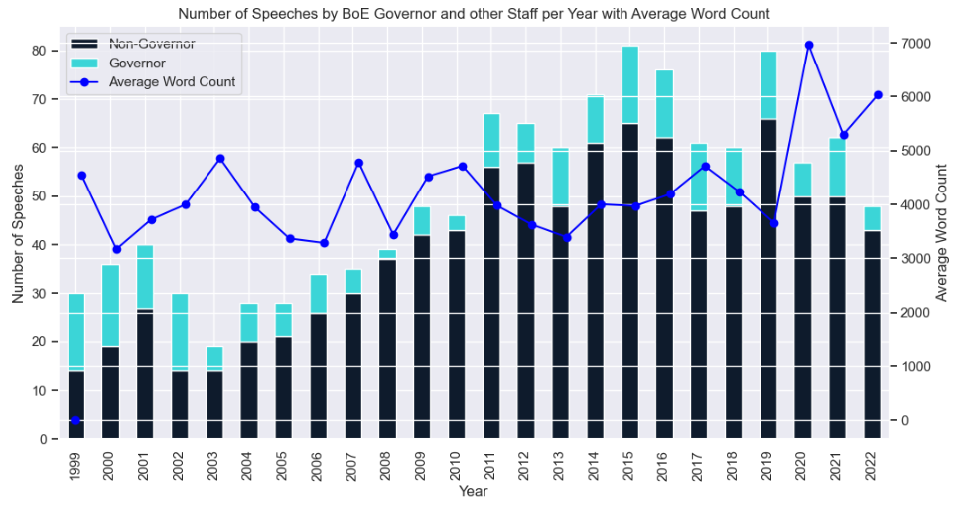
Speech Frequency & Length
Notes:
We have looked at speech frequency and length.
In the bar chart you can see the number of speeches given per year split into speeches given by the governor and by others.
The overall number of speeches has increased, while the share of governor speeches has only increased marginally (the turquoise part).
In terms of speech length, we see an initial drop after 2010.
Public confidence in central banks declined after the financial crash of 2008., so banks re-evaluate their communication strategy with external audiences.
So with shorter speeches given by different people, the BoE can reach a wider audience.

Slide 7
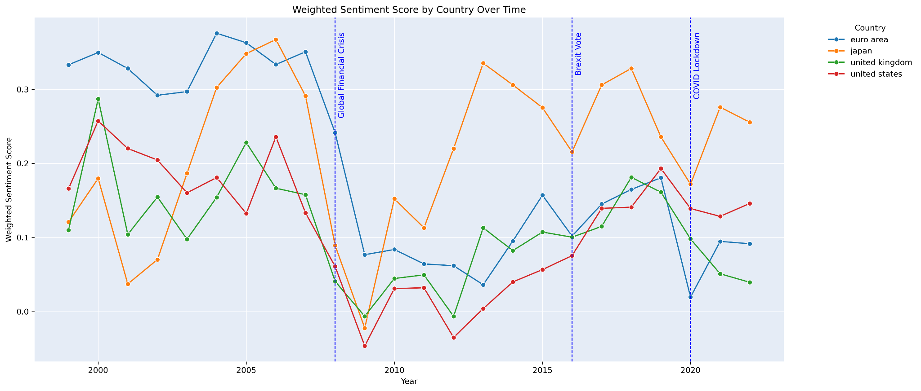
Speech Sentiment Country Comparison
Sentiment Score by Country over Time
Sentiment Score
Notes:
We also looked at speech sentiment across countries and regions. Here you can see the UK in green and the US and Euro Area and Japan.
Since the financial crisis up to 2022, the BoE speech sentiment moves in line with its major political and economic partners like the US and the Euro Area (the red and blue lines).
This diverges during covid, probably due to the very different lockdown policy stance taken in the US.
Japan is a bit of an outlier, which would need to be explored further.
For speeches outside the UK and the US which were either translated or given by non-native English speakers, a deeper regional analysis with reflection on the wordlist could give more insights.

Slide 8
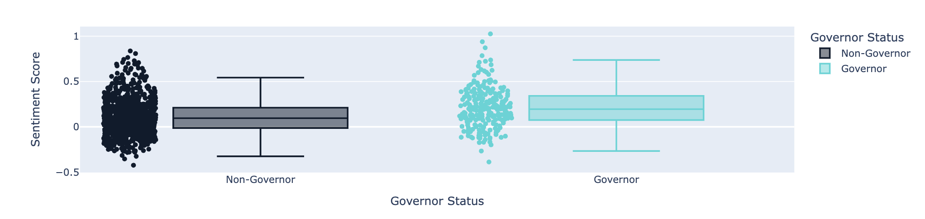
Speech Sentiment by Author
Notes:
We also looked at speech sentiment by author.
Speeches delivered by governors (the data on the right in turquoise) tend to have slightly higher average sentiment scores compared to other authors.
This suggests that governors generally use more positive and reassuring language, reinforcing their function as stabilising voices during economic communication.
Non-governor speeches exhibit greater variability, likely because the topics and authors are more varied.
This trend also persists over time.

Slide 9
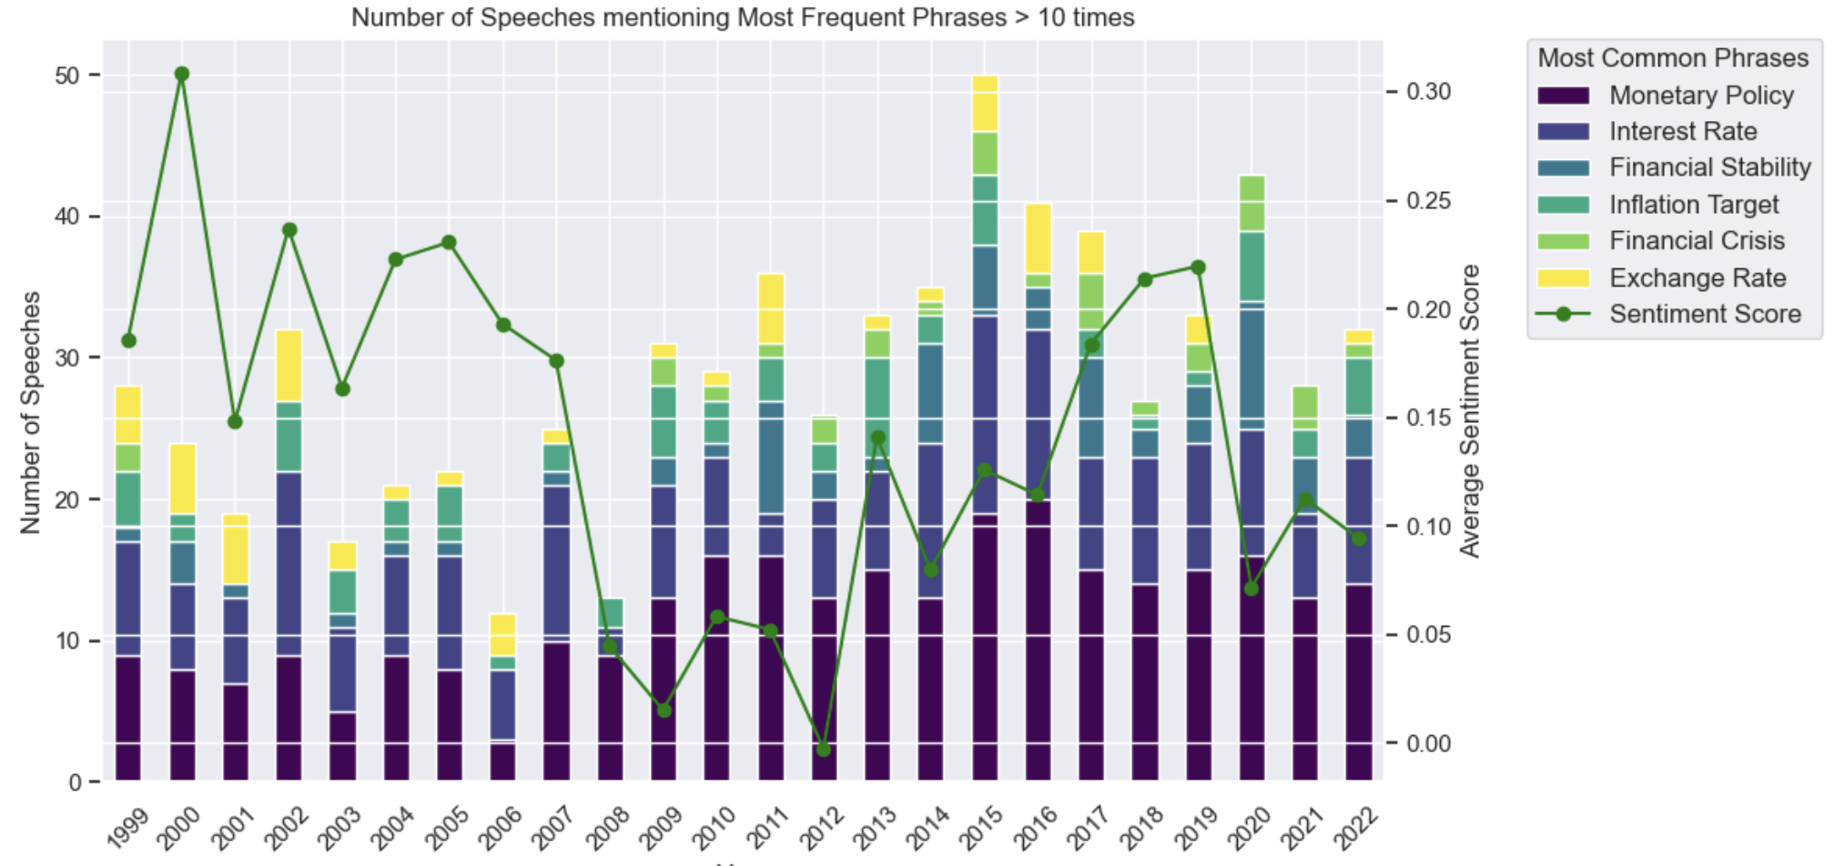
Speech Content by Top Common Phrases
Notes:
And we also looked at speech content.
We have used CountVectorizer to to count how often the most common word groups were used in the speeches.
The bar chart here shows the number of speeches per year in which a particular word group was used more than 10 times.
More speeches use the phrases monetary policy and interest rates more than 10 times, and the number is increasing over time (dark purple and dark blue bars).
On the other hand, the term financial crisis (in light green) only starts to be used after the crisis of 2008 and remains a relevant topic.
The green line is the average sentiment score over time.
Overall, we can see that the number speeches using the most common phrases more than 10 times drops in more positive times, and other topics can be discussed.

Slide 10

How does speech sentiment relate to economic events?

Slide 11
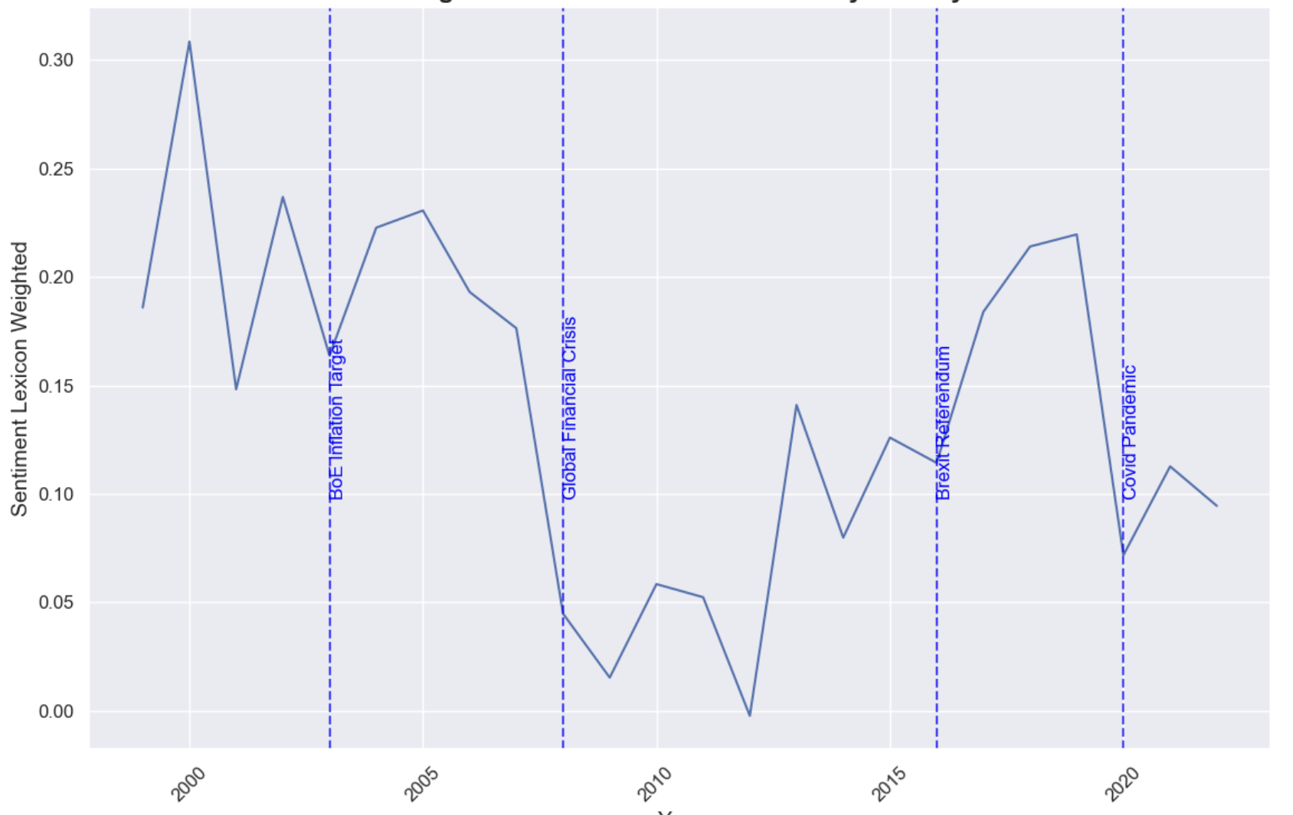
Sentiment Scores at Key Events
Sentiment Score
Average Sentiment Score
Notes:
Average Sentiment Score over time between 1999 and 2022.
At key events like the financial crisis and the Covid pandemic you can observe a reduction in the average speech sentiment around that year.

Slide 12
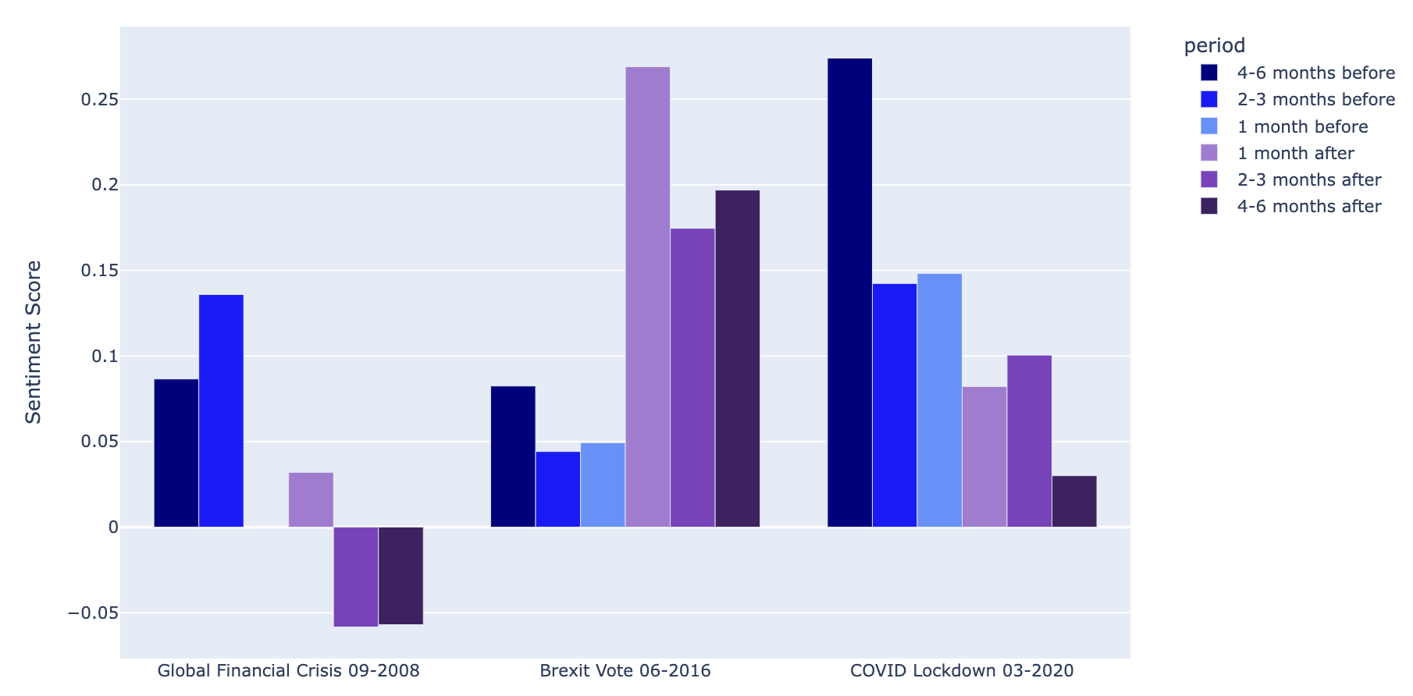
Sentiment Scores before & after Key Events
Notes:
Looking at speech sentiment around these events in more detail, we can see average sentiment in the 6 months before the event in blue and in the 6 months after the event in purple.
Events with a higher surprise factor show less positive sentiment scores after the event.
For lockdown – the 2 to 6 months before, sentiment was more positive, and then dropped, maybe because the severity of the situation was unexpected.
After Brexit referendum on the other hand speech sentiment scores became more positive. As the referendum was not an unexpected event, policies had been put in place to counteract any market reactions, so that the speech sentiment brought across this positive view.
https://www.politico.eu/article/mark-carney-eats-humble-pie-on-brexit/

Slide 13
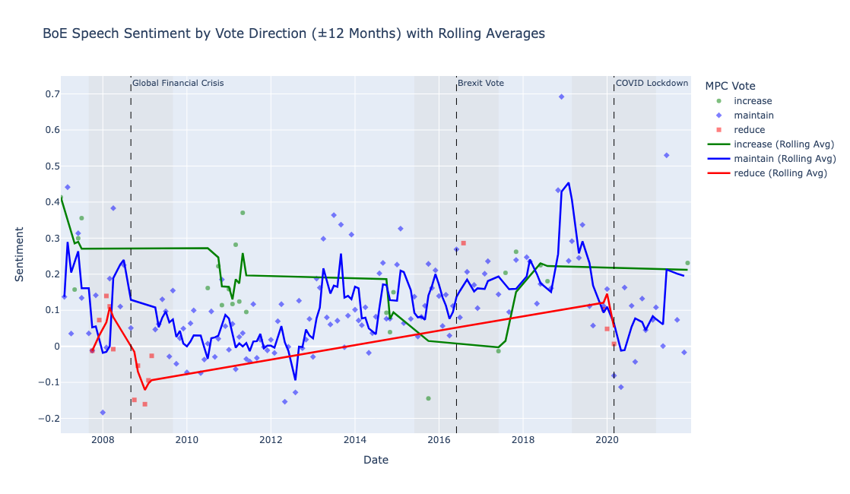
MPC Voting
Bank of England Speech Sentiment by Vote Direction
Sentiment Score
Notes:
And here we also looked at MPC voting on interest rate changes, which is of course the main tool of the Bank of England to take direct impact on the economy.
The dots show monthly average sentiment of speeches per vote type and the lines display the 3-month rolling averages to highlight tone trends.
The shaded areas show ±12 months around major events.

Slide 14
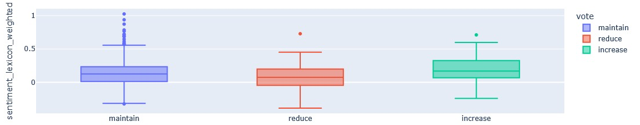
MPC Voting
Bank of England Speech Sentiment by Vote Direction
Sentiment Score
Speech Tone by Vote Decision
Sentiment Score
Notes:
Speech sentiment around decisions to increase rates shows a consistently more positive score. Increases are used to control inflation and more positive speech sentiment reflect the increase as countermeasures.
Speech sentiment around decisions to maintain rates shows a more moderate tone and speech sentiment might also depend more on other factors.
The decision to reduce rates was often taken in times of crisis, resulting in a more negative speech sentiment overall.
Shows that BoE communication tone aligns with key events to maintain financial stability.

Slide 15
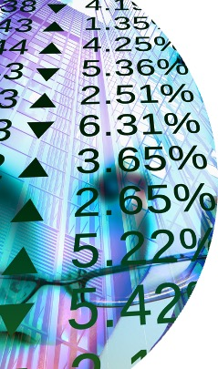
How is speech sentiment correlated with economic indicators?
Notes:
Indicators: Interest rates, GDP, Unemployment Rate, Credit Growth, Consumer Confidence, inflation, property prices, exchange rates, FTSE 250 and government bonds,
We did not use FTSE 100 as this includes mainly global companies, while the FTSE 250 also includes companies more generally impacted by UK policy.
Speech sentiment does not linearly correlate with the individual indicators, as the economic variables are all intrinsically linked.
We tested this both ways but did not find strong predictions either ways.

Slide 16
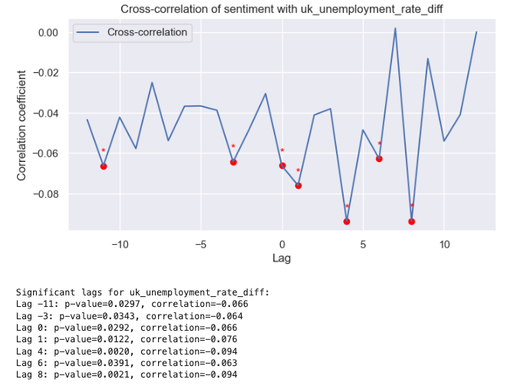
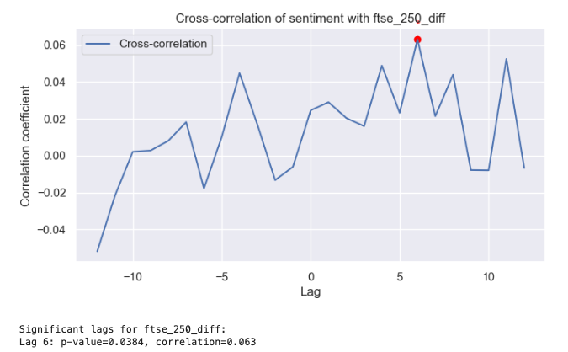
Cross Correlation – Examples
Cross Correlation of Speech Sentiment and Unemployment
Cross Correlation of Speech Sentiment and FTSE 250
Notes:
We did find some interesting results with cross correlation, showing the largest peaks and the red dots show statistical significance.
Unemployment: significant negative correlations which suggest that more positive speeches tend to be followed by declines in unemployment rate changes after about 4-8 months.
FTSE 250: When central bank speeches are more positive or optimistic, there tends to be a small but significant rise in the FTSE 250 index about 6 periods afterward.

Slide 17
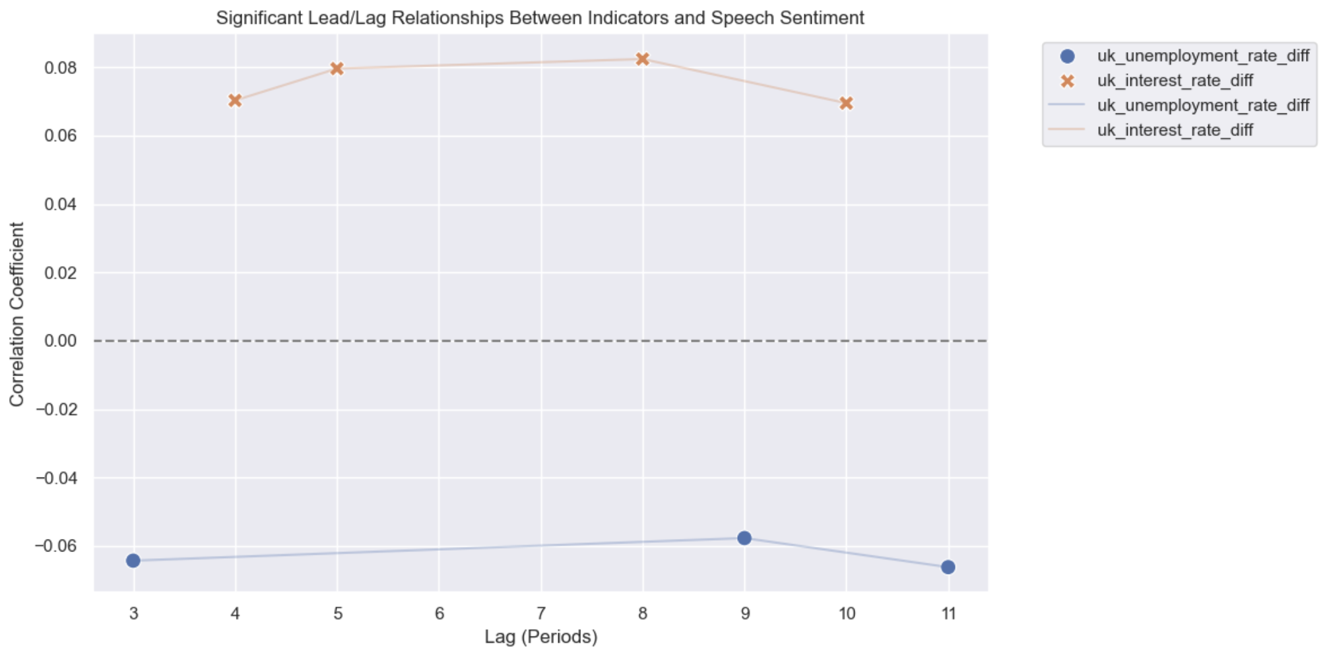
Cross Correlation – Examples
Unemployment Rate
Interest Rate
Unemployment Rate
Interest Rate
Notes:
Here we then looked at whether the economic indicators impact future speech sentiment.
For interest rates, when they increase, the BoE communicates in a more positive tone shortly afterwards, signalling confidence in policy normalisation or economic resilience.
This is in line with the sentiment analysis around MPC voting from earlier.
For unemployment we found that higher unemployment rate tend to be followed by more positive speech sentiment after about 3 to 8 periods, so in line with the results on the previous slide.

Slide 18
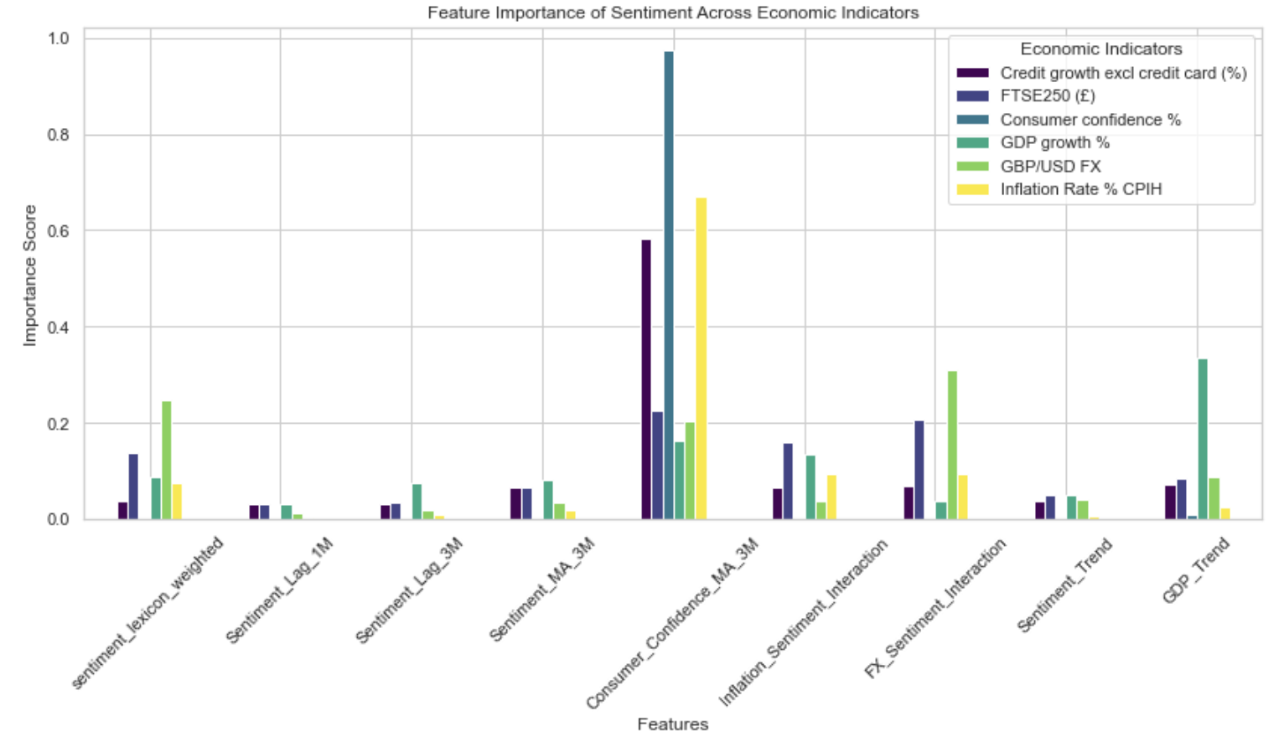
Feature Importance by Indicator
Notes:
We followed this by more in in depth correlation analysis using OLS, random forests and XGBoost models.
The XGBoost nodel outperformed the other and the feature importance in the model can be seen here.
We applied the model to weighted and non-weighted speech sentiment scores, which had similar results.
For the sentiment score we also used different lags and transformations, but still no strong predictive links were found.
However, speech sentiment scores make small contributions to the prediction of the FTSE250, the exchange rate to USD and GDP Growth.
To test for higher significance, other feature were introduced, and consumer confidence appears to be a strong predictor and dominates economic forecasting in this model.

Slide 19
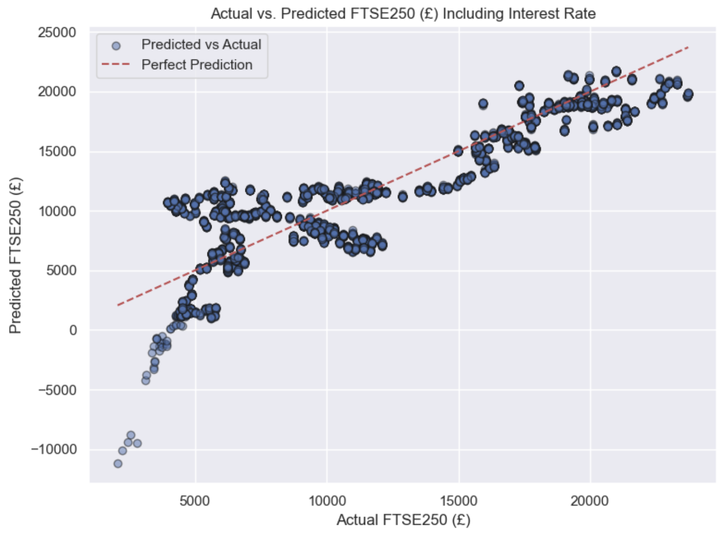
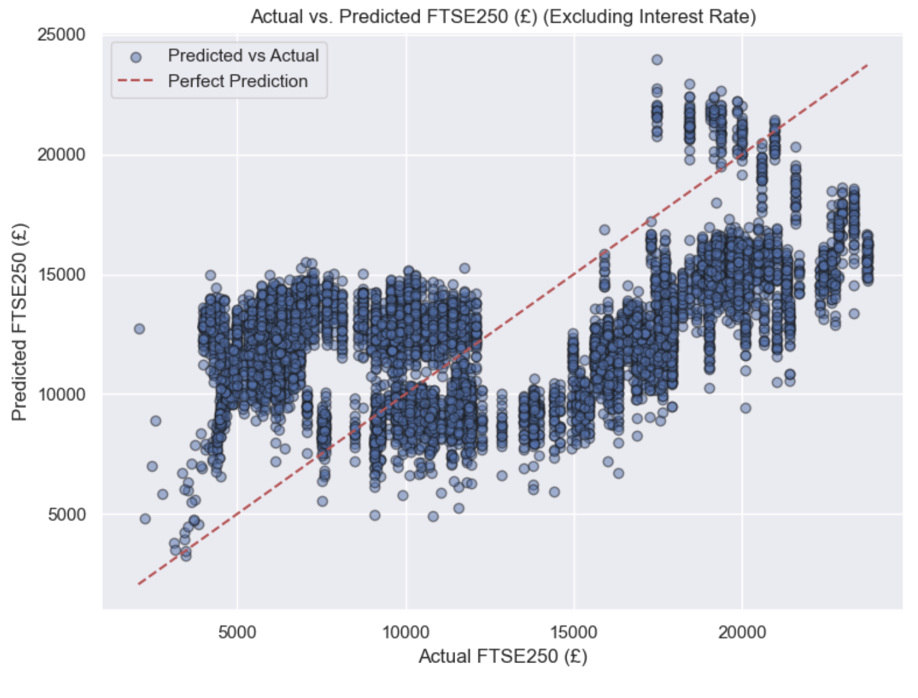
Deep Dive: FTSE 250
Notes:
As speech sentiment has some impact on FTSE250 and the FTSE 250 is good measure for economic conditions, as it reacts more rapidly to changes, we did a deep dive into this indicator and applied a broader model with more features.
You can see here, that interest rates are crucial - The analysis on the left including interest rates shows a much better fit than without on the right.
This improves prediction, although substantial variability remains.

Slide 20
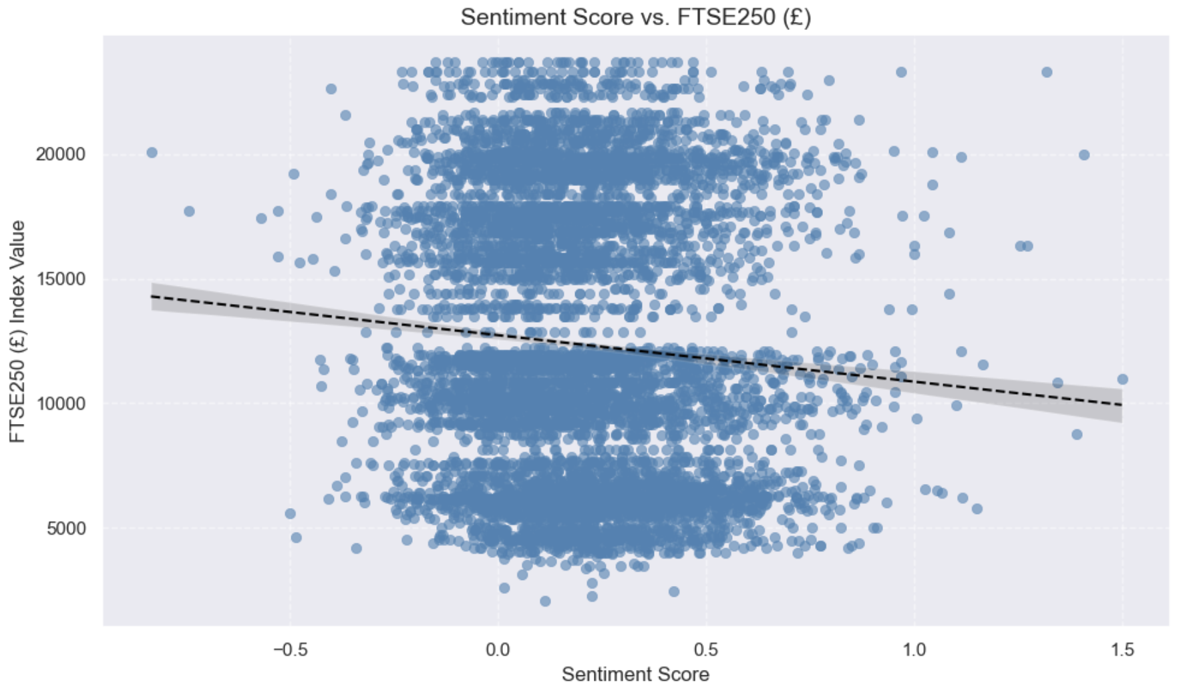
Deep Dive: FTSE 250
Notes:
Overall, the deep dive shows that speech sentiment alone is not a sufficient predictor, as FTSE250 values vary widely across similar speech sentiment scores.

Slide 21

Recommendations & Future Opportunities
Notes:
So what about our recommendations and future opportunities?

Slide 22
Key Insights
Bank of England speeches are increasingly concise & frequent.
Governor tone is more optimistic.
Major events and MPC voting results drive shifts in speech sentiment.
Weak correlation of speech sentiment with economic indicators.
Hybrid models offer stronger predictive insights.
Most influential features are consumer confidence, interest rates, credit growth and unemployment.
Notes:
Let‘s remember the key finsights:
We saw that speeches changed over time to shorter more frequent communications.
Speech sentiment changes depending on speech authors and around key economic events and MPC voting results.
It is important whether events are anticipated or have a surprise factor.
Only weak correlations between speech sentiment and economic indicators were found, and a more robust model must be developed.
This model should include interest rates and consumer confidence.
Interest rates are already a major tool for the BoE and we think that consumer confidence should be leveraged more.
So how can these results be used in the speech and communication strategy of the Bank of England?

Slide 23
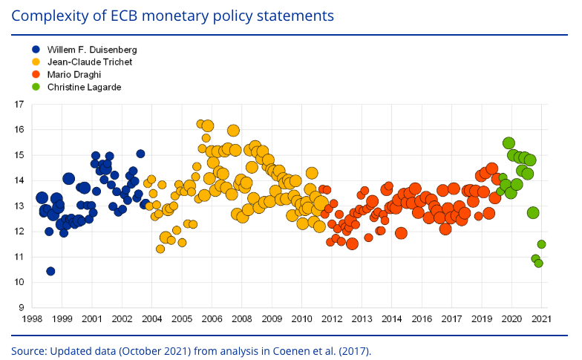
Communication Analysis
Source: Marius Gardt, Siria Angino, Simon Mee, Gabriel Glöckler, ECB communication with the wider public
Notes:
The overall communication strategy should consider speech language in addition to sentiment.
The figure depicts the length and the complexity of the ECB’s monetary policy statements.
The length is measured by the number of words (indicated by circle size).
The difficulty of the language employed indicates how many years of formal training are required to understand the text.
This model could also be applied to the BoE communications to help the Bank of England to reach a wider audience and increase consumer confidence, which could have a more direct impact on other factors in the economy.
https://www.ecb.europa.eu/press/economic-bulletin/articles/2022/html/ecb.ebart202108_02~5c1e5a116d.en.html
Flesch-Kincaid Grade Level score, based on the length of its sentences and words.

Slide 24
Recommendations
Strengthen communication impact
Expand sentiment dictionary
Monitor language complexity
Leverage sentiment in policy communication
Notes:
Use speech analysis to strengthen communication impact
To have a consistent sentiment analysis over time, we recommend to expand the Bank of England‘s custom sentiment dictionary
To fully reflect UK-specific financial and policy language and include domain-relevant terms to improve sentiment nuance
To reduce negative skew by capturing cautious vs optimistic tone more accurately
For cross country analysis translation adaptations must be made
Language complexity should also be measured as part of the dictionary.
Define measures of speech complexity and how it impacts consumer confidence
Analyse how speech complexity changes over time
Leverage sentiment in policy communication
Clear, concise and transparent language should be used to boost transparency and audience reach.
Use tone to reinforce market stability, especially during times of crisis

Slide 25
Recommendations
Strengthen modelling precision
Hybrid model simulations of complex scenarios
Broader inclusion of economic indicators
Enhanced analysis of key economic events
Notes:
Use speech analysis to strengthen modelling precision
As speech sentiment alone has limited predictive power, it should be used as part of a wider model to simulate complex scenarios
Combine sentiment with additional macroeconomic variables, such as gilt yields
⁠Use rolling sentiment as an early warning or leading indicator
⁠Deepen the analysis around key events, such as interest rate votes, and whether the events were anticipated or surprises

Slide 26
Recommendations
Strengthen policy accountability
Visualise tone shifts with a Policy Risk Radar Dashboard
Deliver concise, data-driven sentiment briefings to executives
Notes:
Use speech analysis to strengthen policy accountability and tracking
Develop a Policy Risk Radar Dashboard to track economic uncertainty and its impact on consumer confidence.
- Track more nuanced speech tone and complexity by vote type, macroeconomic trends, and windows around key events
- Visualise tone shifts relative to key policy milestones
Use dashboard for regular briefings for executives to support strategic planning,
- Highlight tone and complexity trends, author variation and market reactions
- Support strategy and crisis planning with tone-driven insights, especially during volatile periods.

Slide 27
Opportunities
Integrate broader economic data & event analysis
Enhance thematic analysis
Analyse engagement with the wider public
Goal: leverage speech sentiment to unlock predictive power & strengthen consumer confidence
Notes:
If we had more time, we would now have….
Boader event analysis and indicators: we would research around MPC vote decision and how speech tone varies ahead of expected vs. surprise events
Thematic content: how to speeches using most common word groups correlate to indicators, such as how does speech sentiment for speeches about interest rates correlate with interest rates
Public engagement: analyse speeches and content overall, including speech complexity and community engagement
We would recommend for the data strategy team to use the improved sentiment lexicon scores together with cross statistical analysis to unlock predictive power.
These data and statistical methods combined will help to make data driven decisions and to use communication strategy to engage with the wider public and strengthen consumer confidence.

Slide 28
Bank of England

